Slide 1
Your name, group, a member of the Circuit Trails Coalition

Slide 2
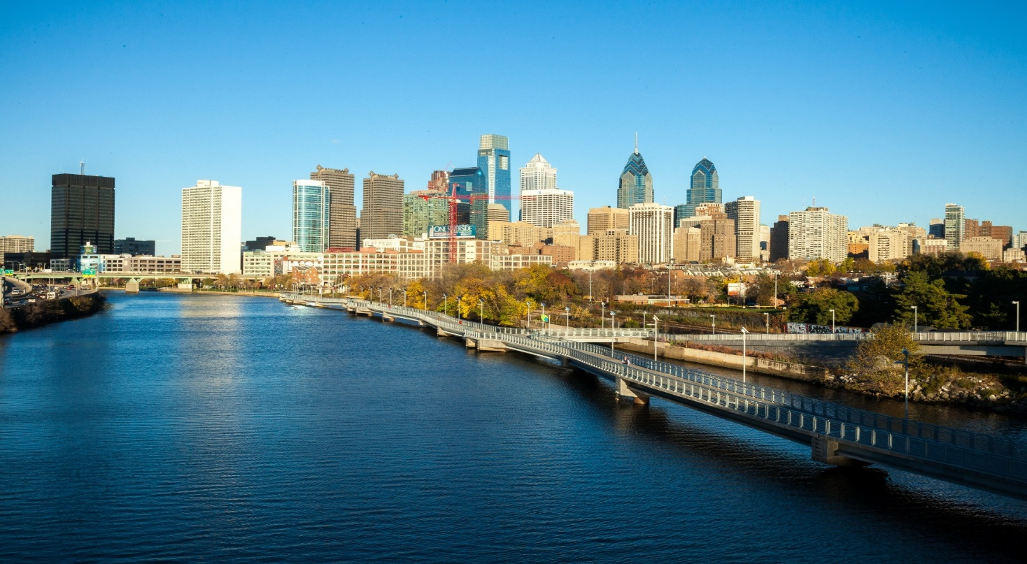
What are the Circuit TRAILS?
Multi-use trail network
Connects people to jobs, communities, parks and waterways
Interconnected network covering the nine-county region
Connects to the East Coast Greenway, linking the region north through NYC and south through Washington, DC

Slide 3
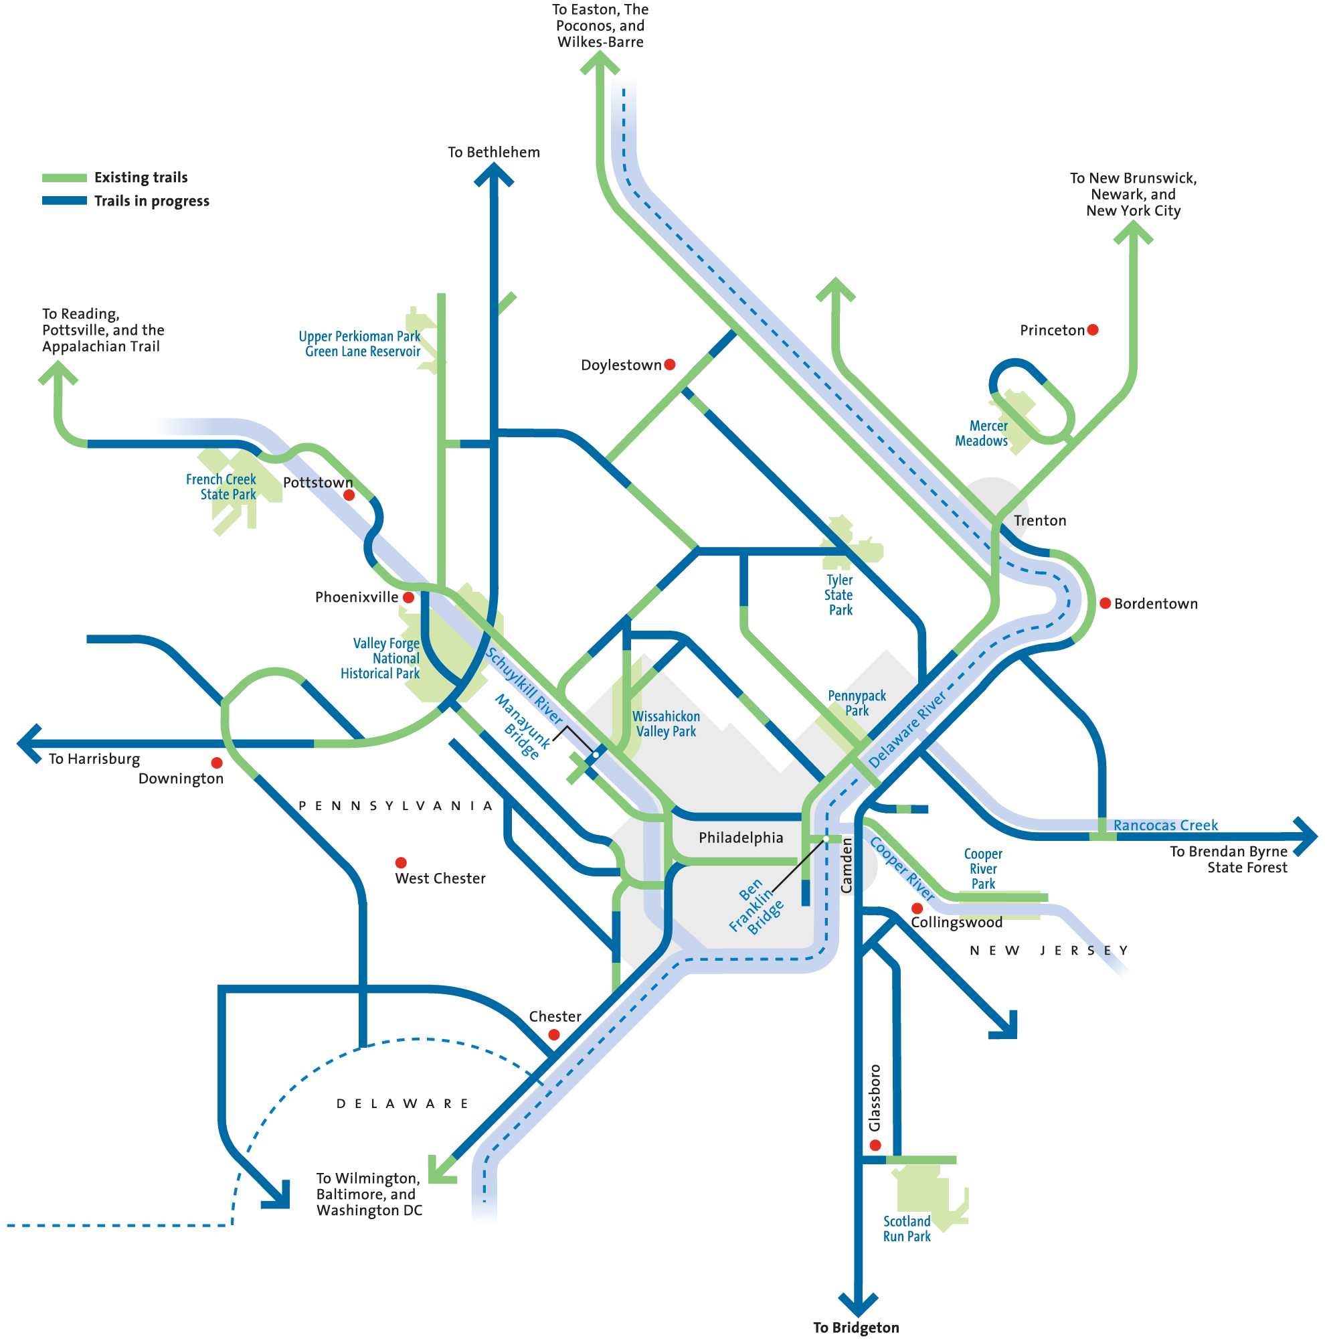
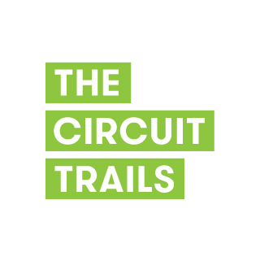

Slide 4
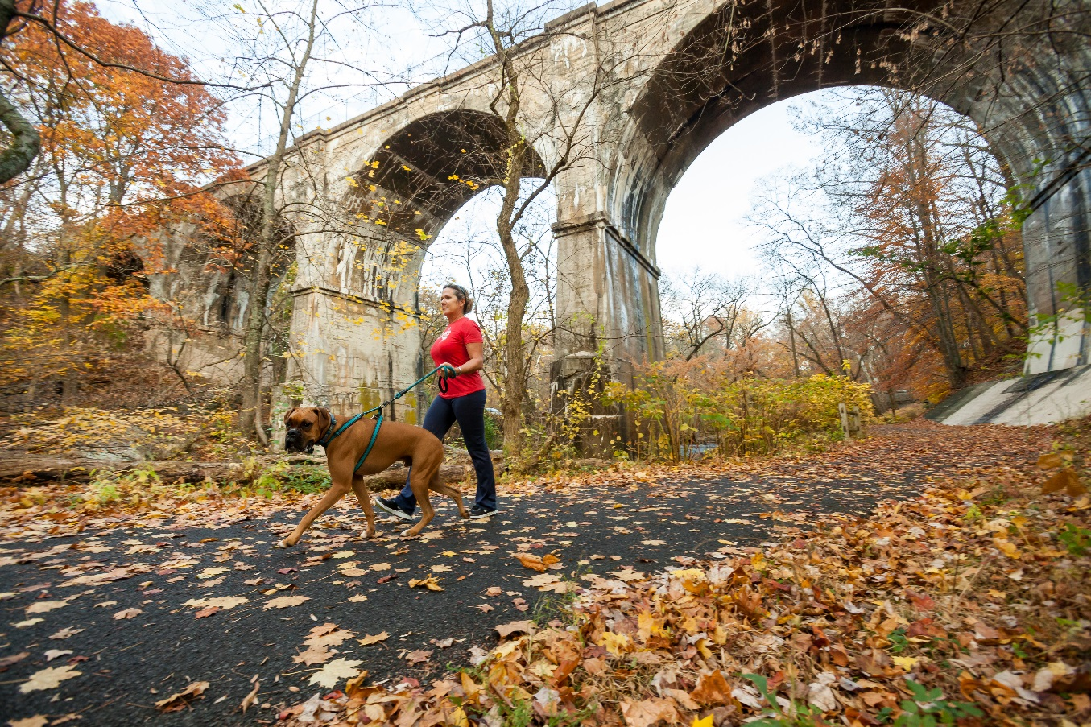
Progress on the Circuit Trails
Vision: More than 750 miles of interconnected, multi-use trails
Completed: 320 miles in PA and NJ
In Progress: 70 miles
Expected in 2017: More than 13 miles of new trails

Slide 5
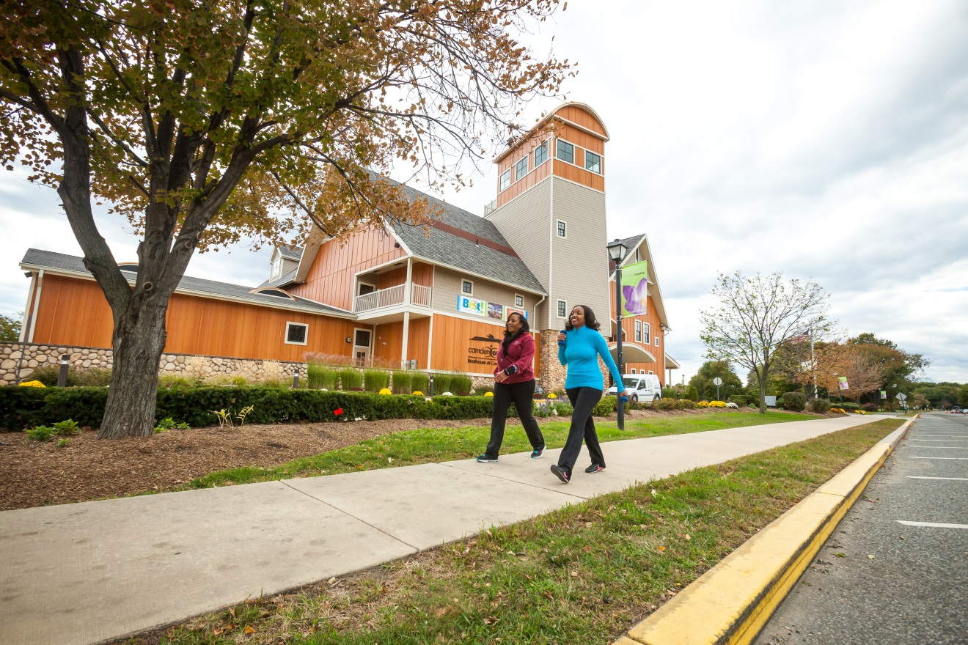
Regional Benefits
Making our region a desirable place to live and work
Linking communities
Connecting residents to green space and waterways
Providing alternative transportation options
Contributing to economic development

Slide 6
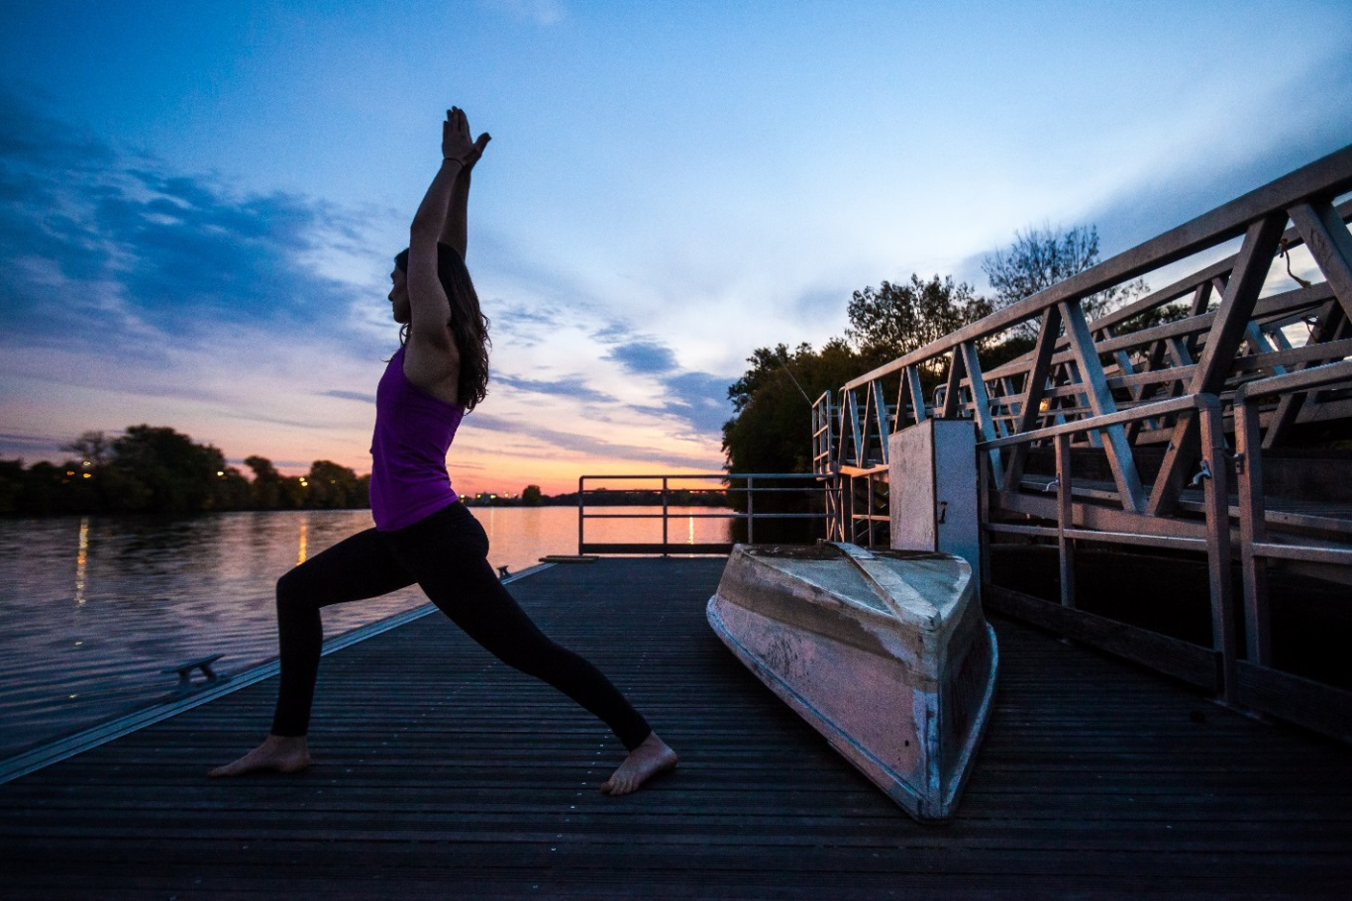
Health and Wellness Benefits
Strengthening healthy transportation and recreation options
Protecting environmental health by providing transportation alternatives
Creating opportunities for exercise, leisure

Slide 7
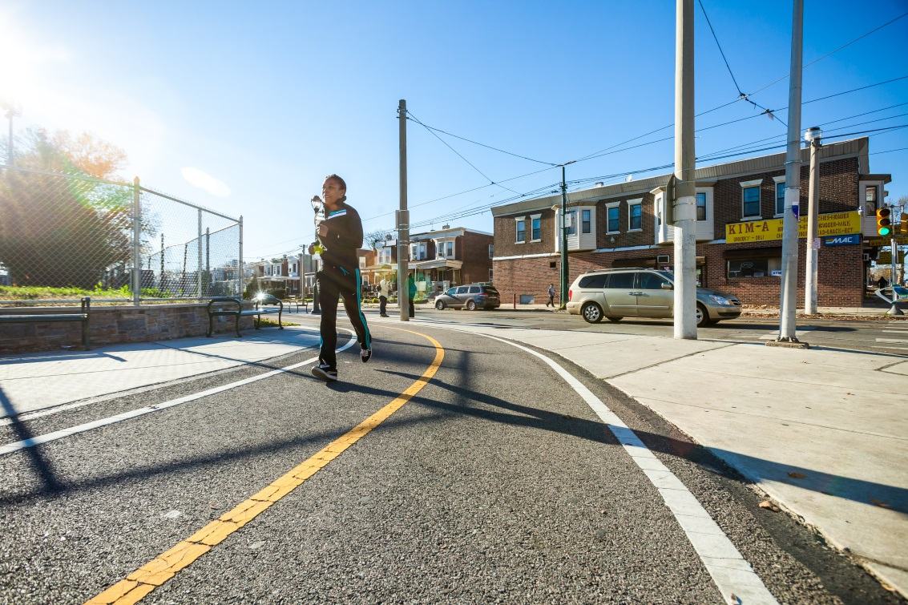
Strong Support for Trails
80% of respondents reported using a trail for recreation or transportation
60% would like to see a trail within 10 minutes of their home
44% use a trail at least once a week
85% supported construction of new trails
*These statistics are from a 2015 regional telephone survey conducted by the Bicycle Coalition of Greater Philadelphia

Slide 8
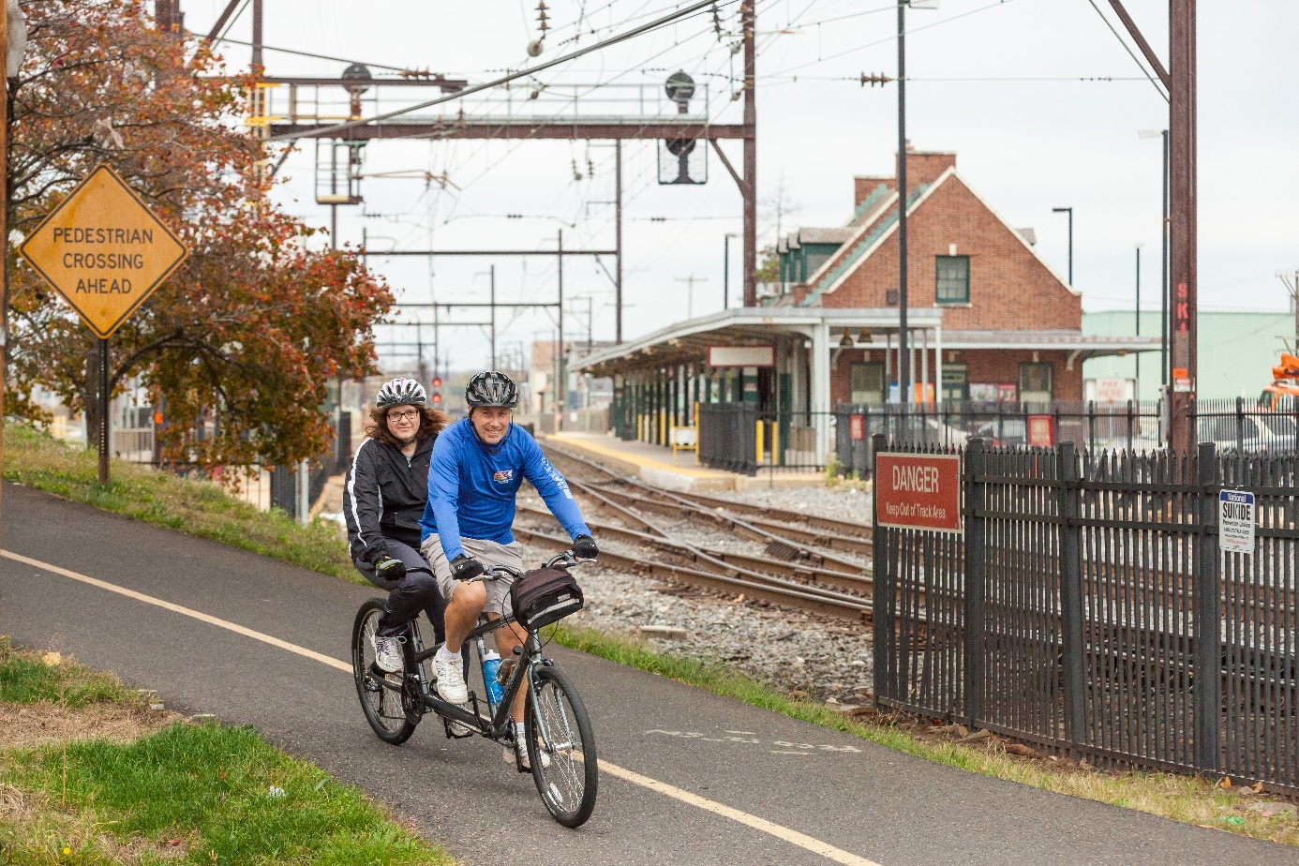
Working Together: The Circuit Trails Coalition
Created in 2012
Coalition of nonprofit organizations, foundations and agencies advocating for the completion of the Circuit Trails
65+ member organizations

Slide 9
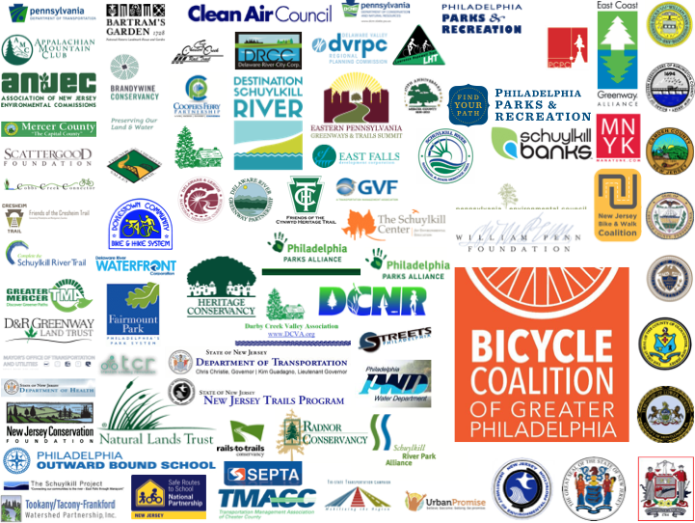

Slide 10
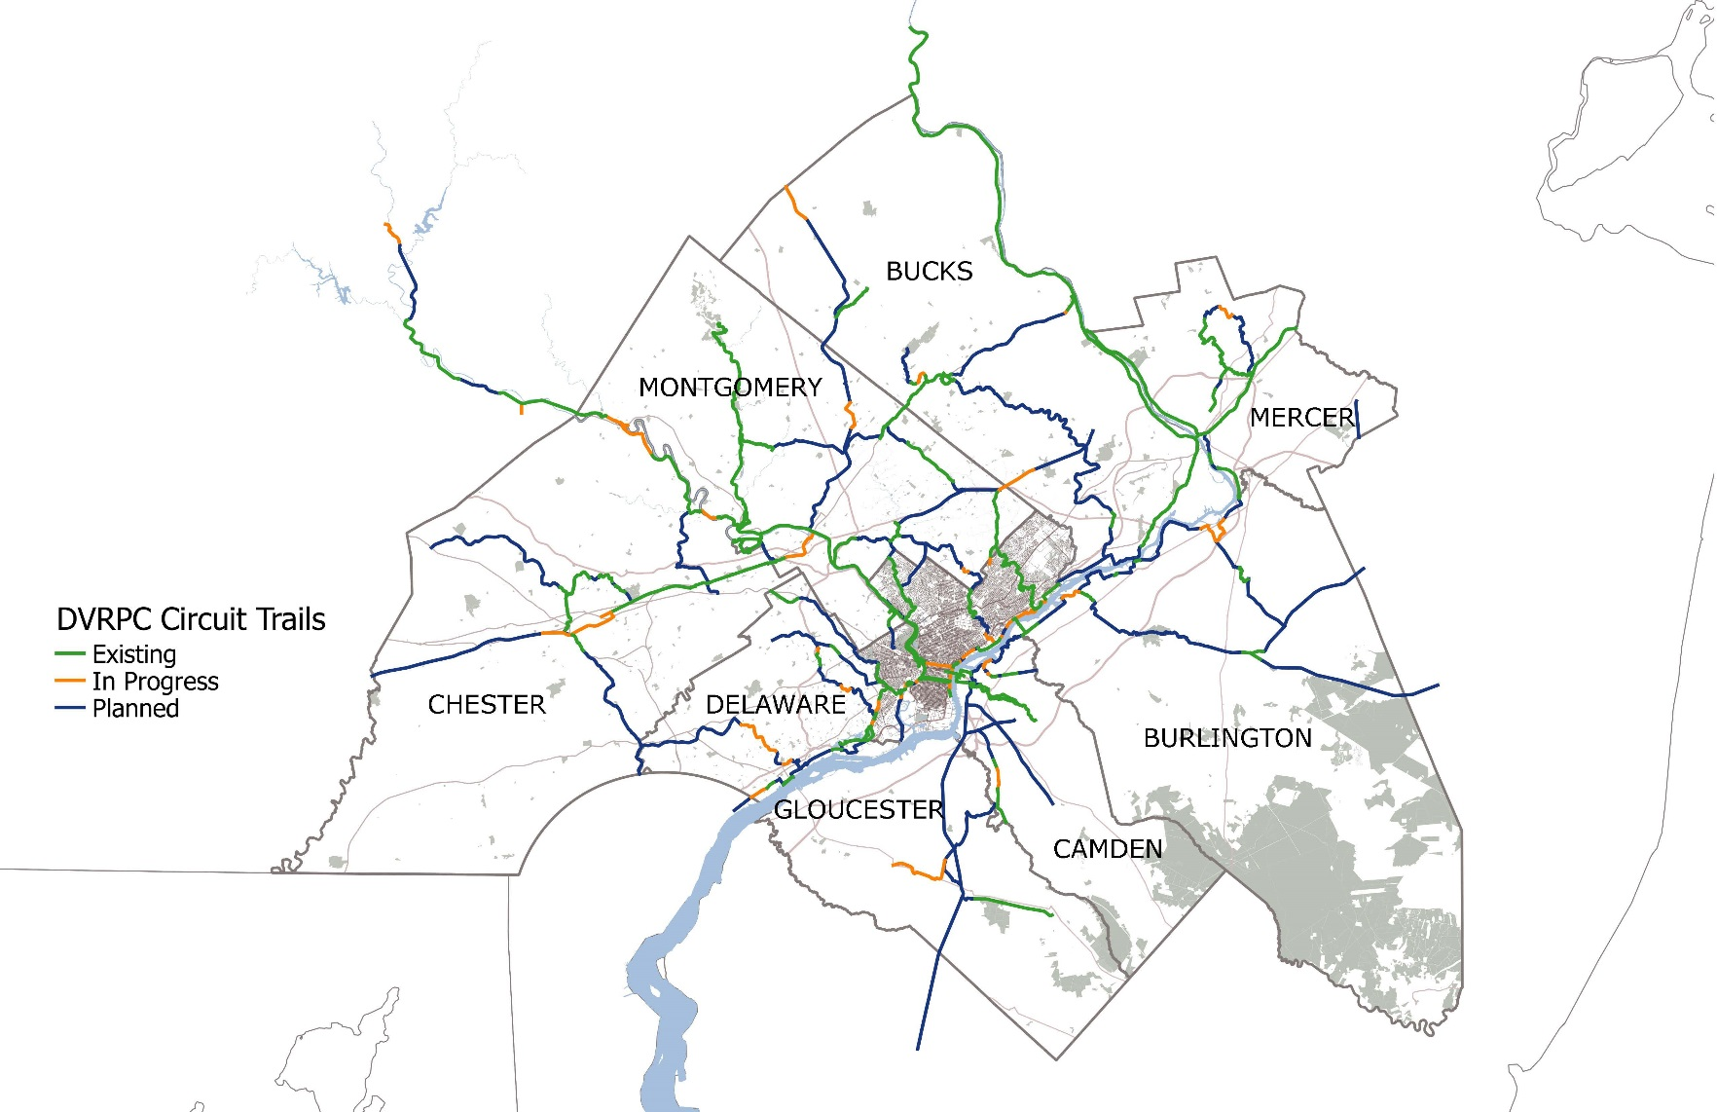
Circuit Trails Status by County

Slide 11
2016 Circuit Trails Status by County

Slide 12
2017 Status – County Breakdown

Slide 13
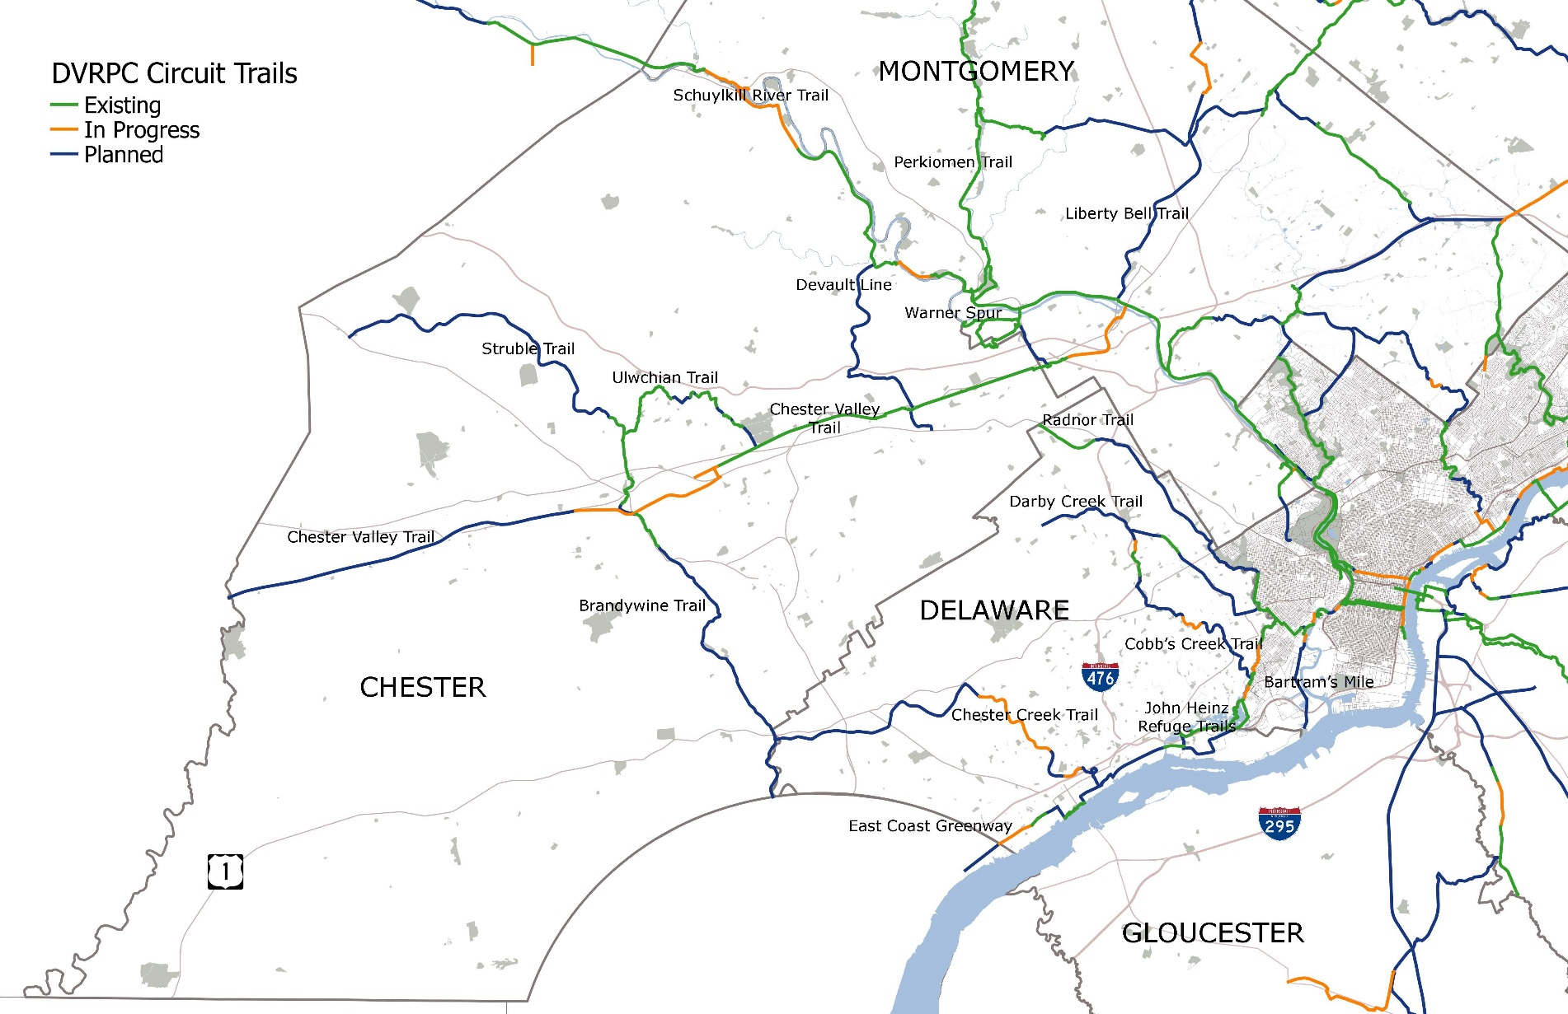
Chester & Delaware Counties

Slide 14
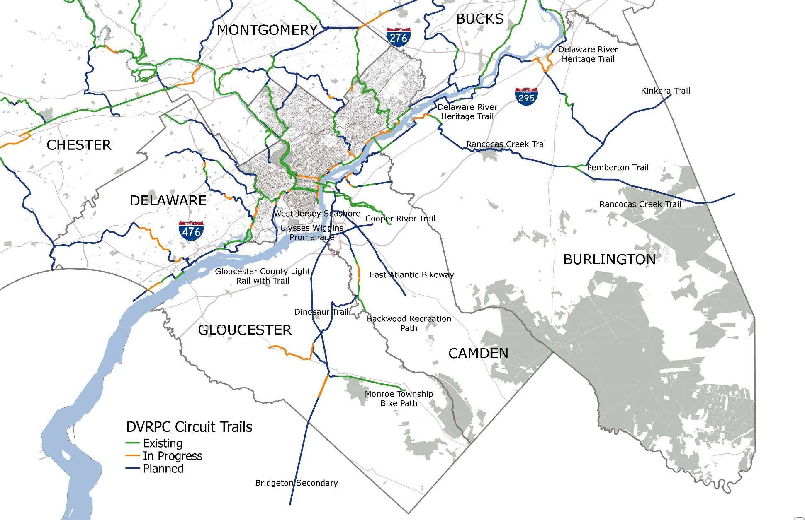
Gloucester, Camden & Burlington Counties

Slide 15
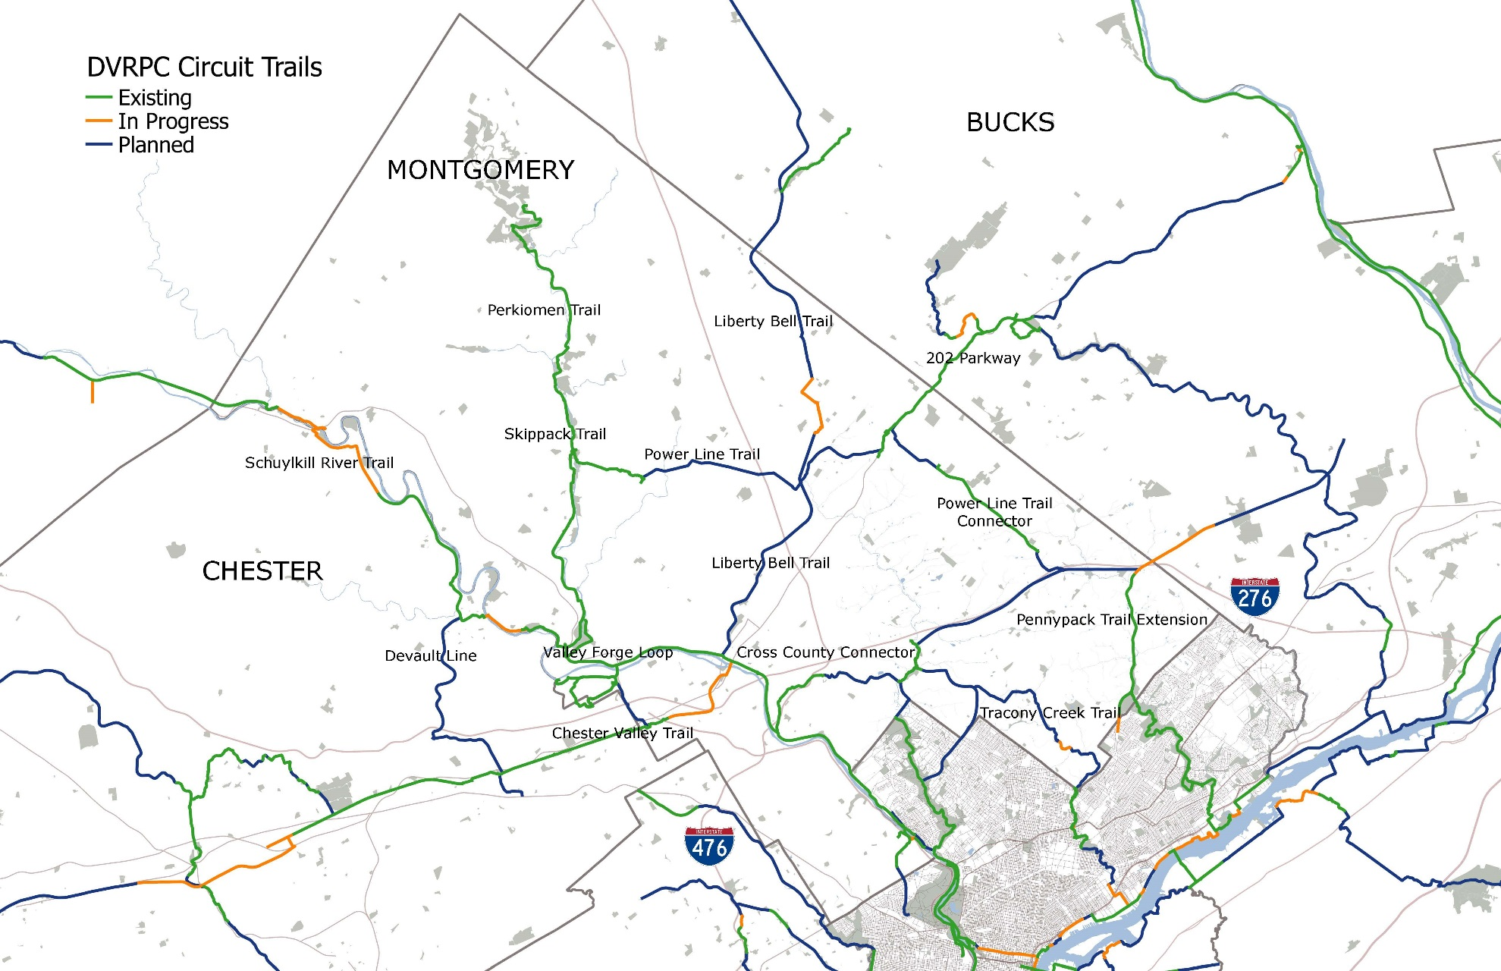
Montgomery County

Slide 16
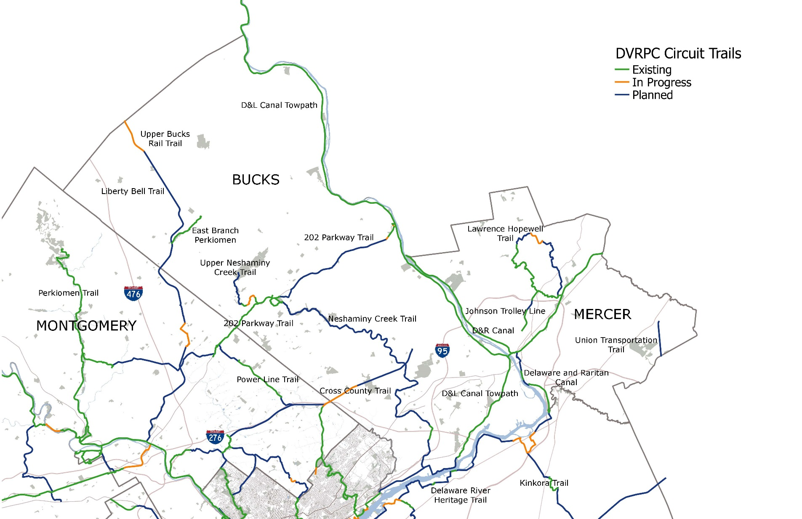
Bucks & Mercer Counties

Slide 17
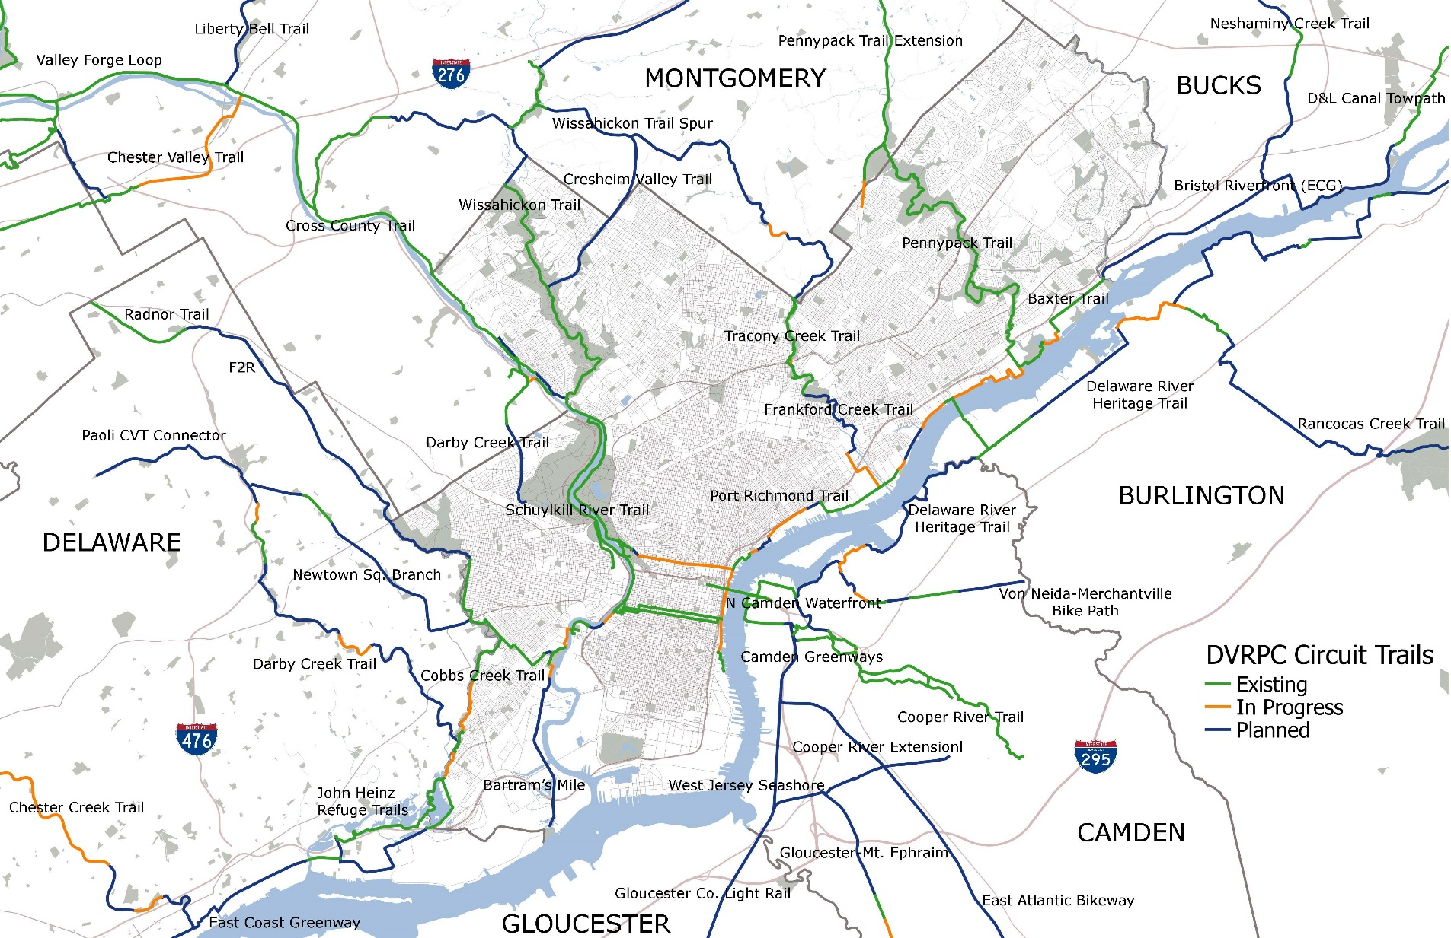
Philadelphia County

Slide 18
A Fresh New Look

Slide 20
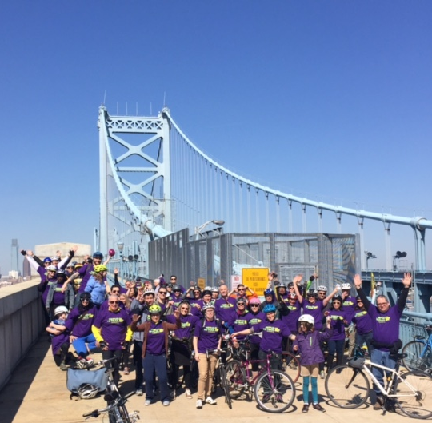
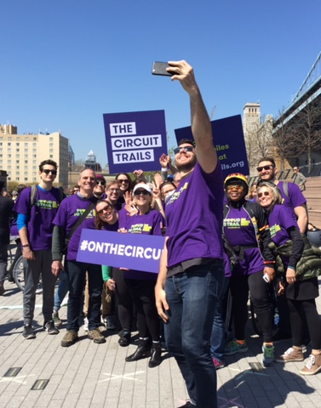

Slide 21
Website
CircuitTrails.org

Slide 22
What’s Next #onthecircuit?

Slide 23
Circuit Trails Coming Soon in 2017
STATE | COUNTY | TRAIL | MILEAGE
NJ | Camden | North Park Drive Bike Lanes | 1.6
NJ | Camden | Cooper’s Poynt Park | 0.4
NJ | Mercer | Trenton Wellness Loop | 1.2
PA | Delaware | Darby Creek – Swedish Cabin to Kent Park | 1.0
PA | Delaware | Marcus Hook ECG | 1.25
PA | Delaware | Tinicum Route 291 ECG | 0.7
PA | Montgomery | Schuylkill River Trail – Keystone Blvd. to Lower Pottsgrove | 1.5
PA | Montgomery | Liberty Bell Trail | 0.6
PA | Philadelphia | Bartram’s Mile North | 0.45
PA | Philadelphia | Bartram’s Mile South | 0.35
PA | Philadelphia | Baxter Trail | 1.5
PA | Philadelphia | Cobbs Creek Trail – Segment A | 1.0
PA | Philadelphia | Cobbs Creek Trail – Segment D | 0.5
PA | Philadelphia | Delaware River Trail – Washington Ave. to Pier 70 | 0.5
PA | Philadelphia | K&T Trail – Phase 1 | 0.9
PA | Philadelphia | Schuylkill River Trail – South St. to Christian | 0.3
 |  | TOTAL 2017 | 13.66

Slide 24
VISION:
Walk out your door. Head north or south, east or west, and you can spend all day on the Circuit Trails.

Slide 25
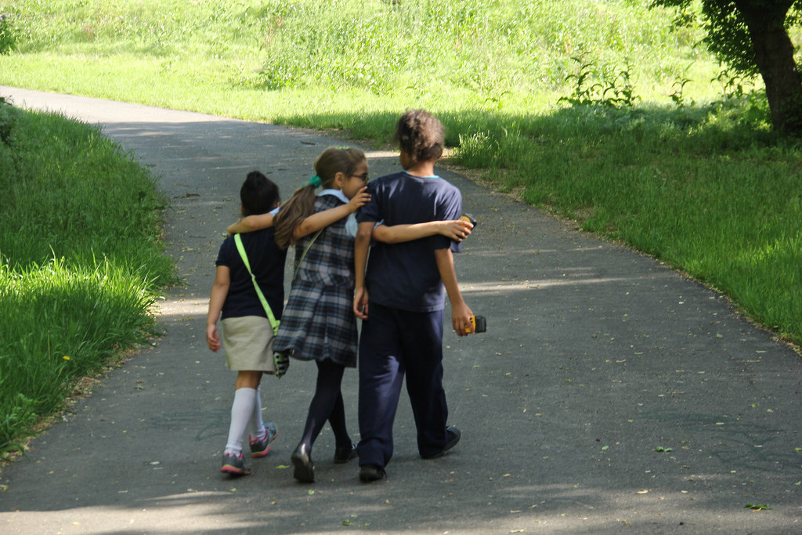
Thank You!
#onthecircuit
www.circuittrails.org

